Slide 1
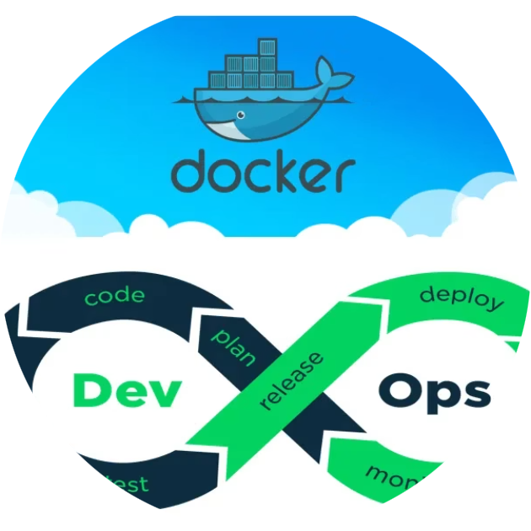

Docker: The Heart of DevOps Automation

Slide 2
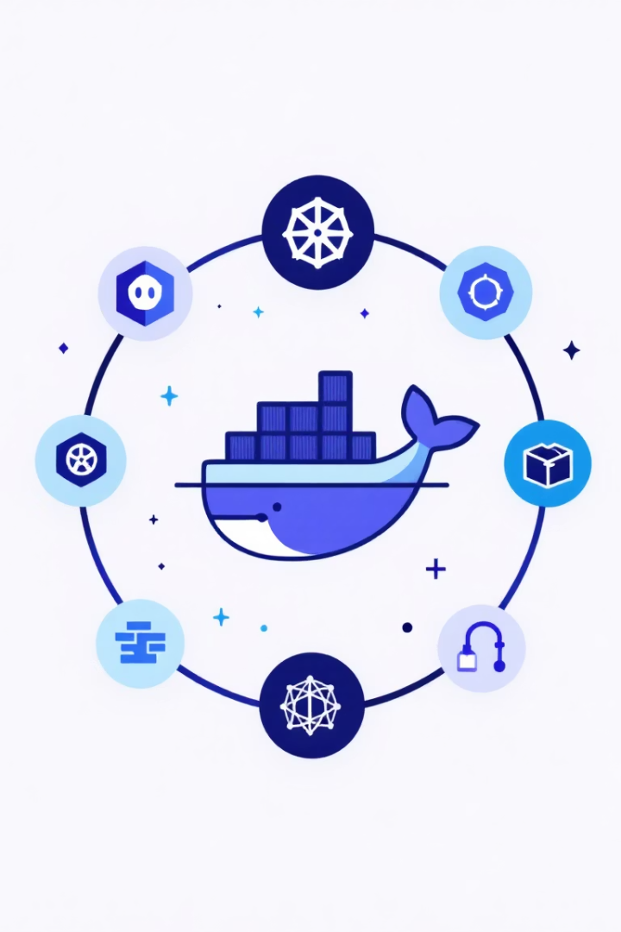
INDEX
Docker Introduction
Why is Docker used in Devops?
Docker Architecture
Docker Installation
Docker commands
Docker Hub
Image Vs Container
Conclusion

Slide 3

DOCKER INTRODCUTION
Docker is an open-source tool designed to automate the deployment of applications inside lightweight, portable containers..

Slide 4
Why is Docker used in Devops?
Consistency Across Environments
Faster Delivery
Simplified Deployment
Scalability
Isolation

Slide 5
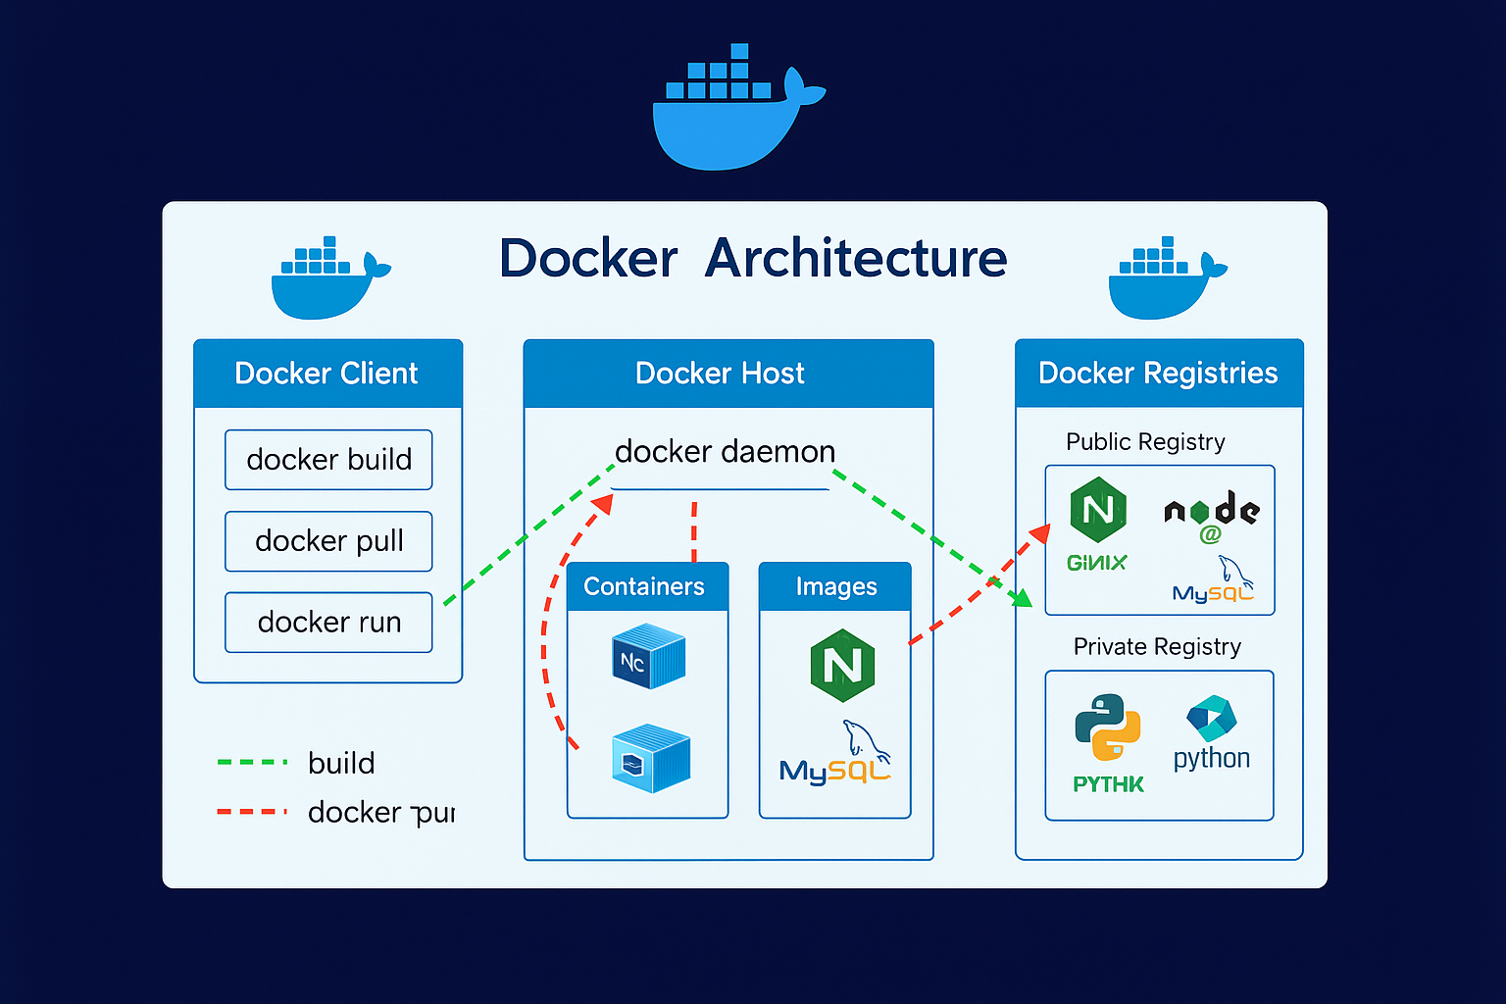

Slide 6



DOCKER INSTALLATION
Step 1: Install Docker on EC2
Install Docker:
2. Check Docker Version:
Start Docker Service:

Slide 7


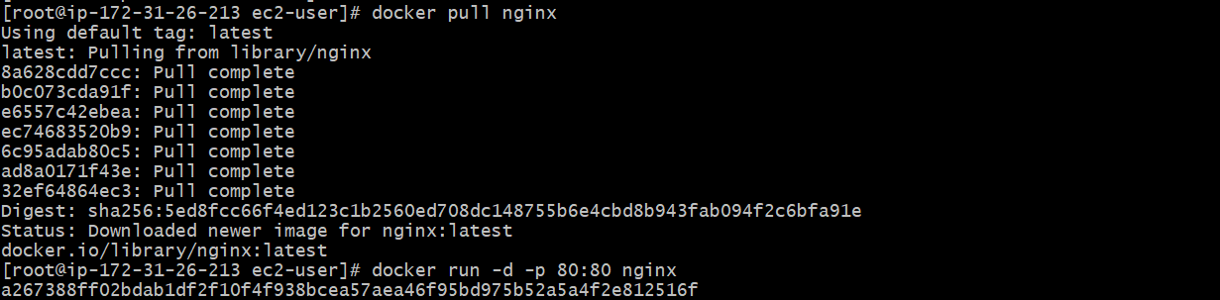
4. Check Docker Info:
5. View Docker Directory:
pull the docker image from online(official website):
1.

Slide 8
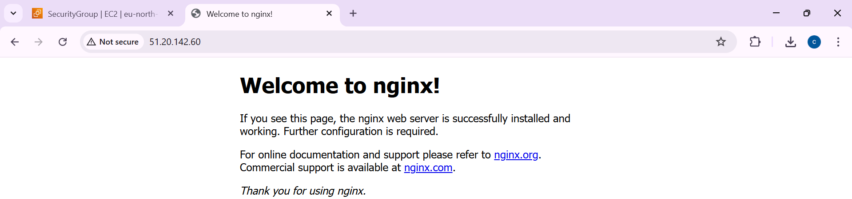

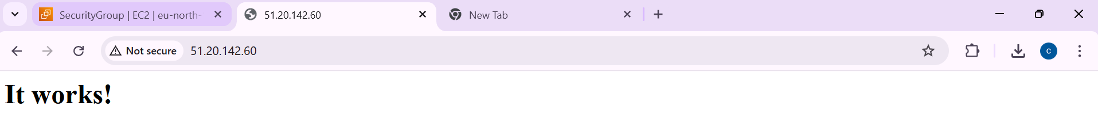
2.

Slide 9
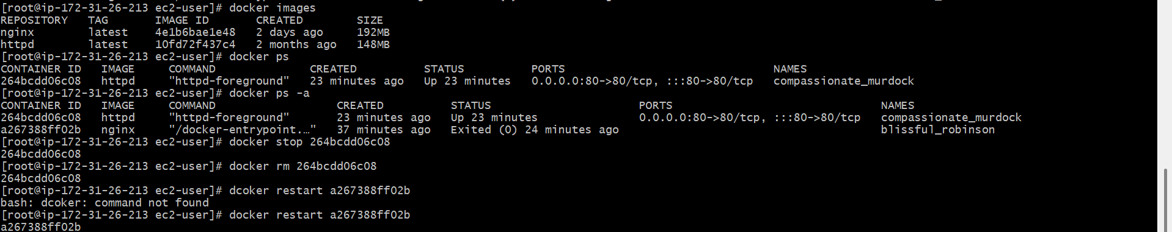
Docker Basic commands:

Slide 10
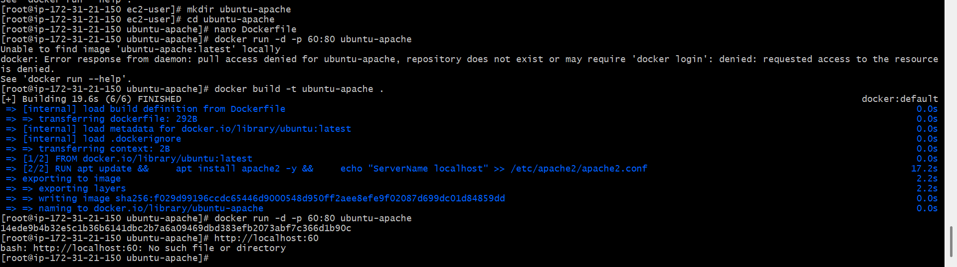
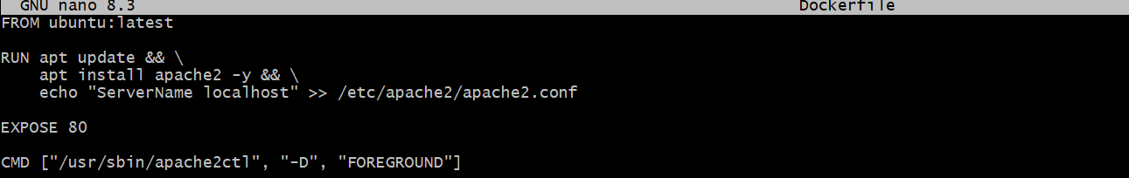

we can get the docker image by wrritting a docker file:-.

Slide 11
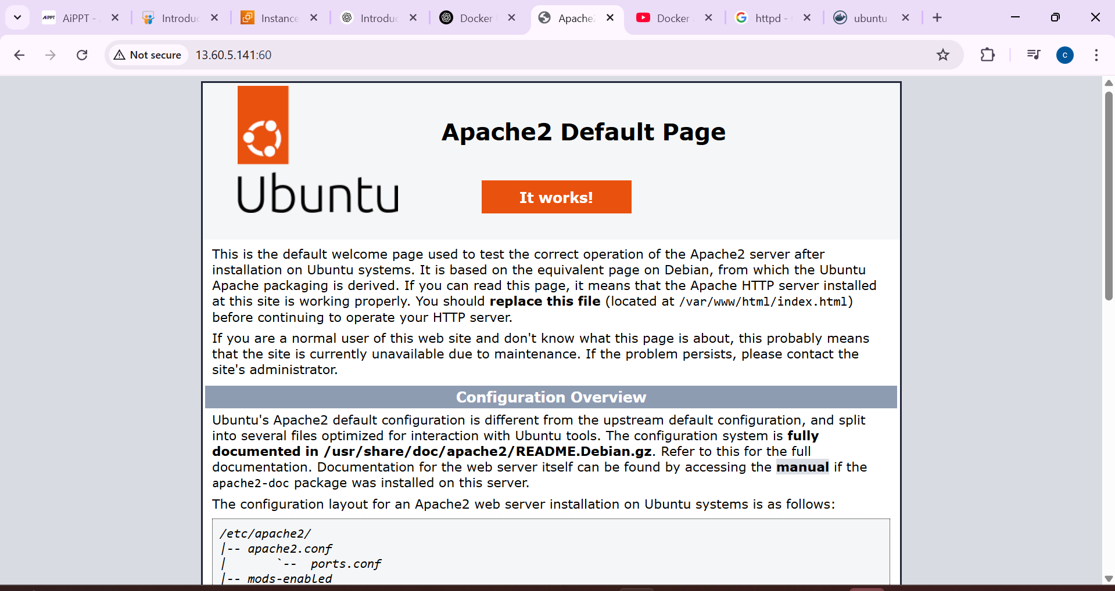

Slide 12
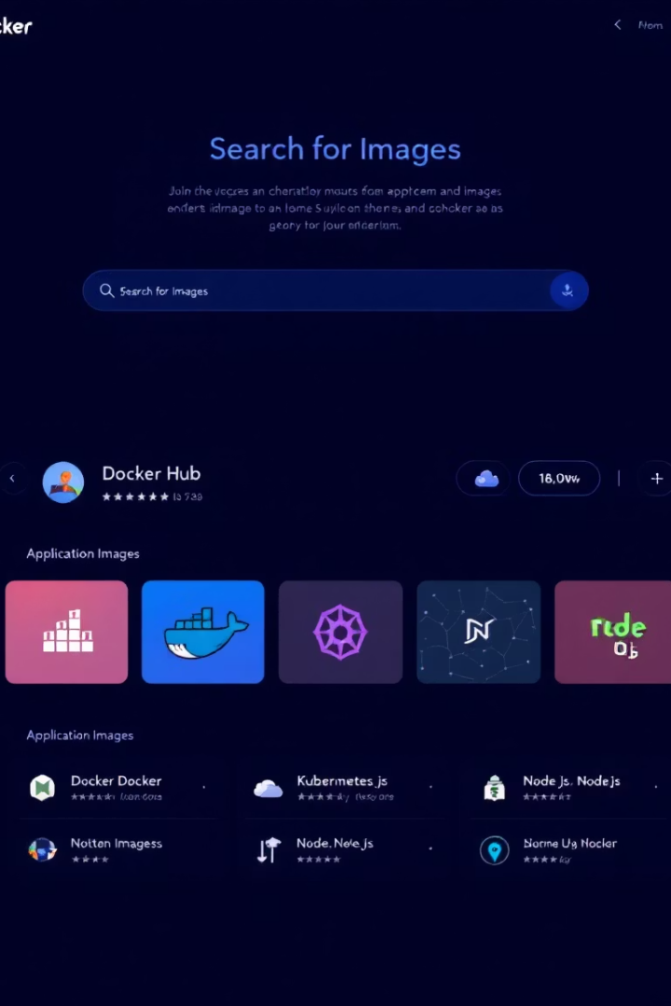


Docker Hub
Push
Pull
Upload images to Docker Hub.
Download images from Docker Hub.

Slide 13
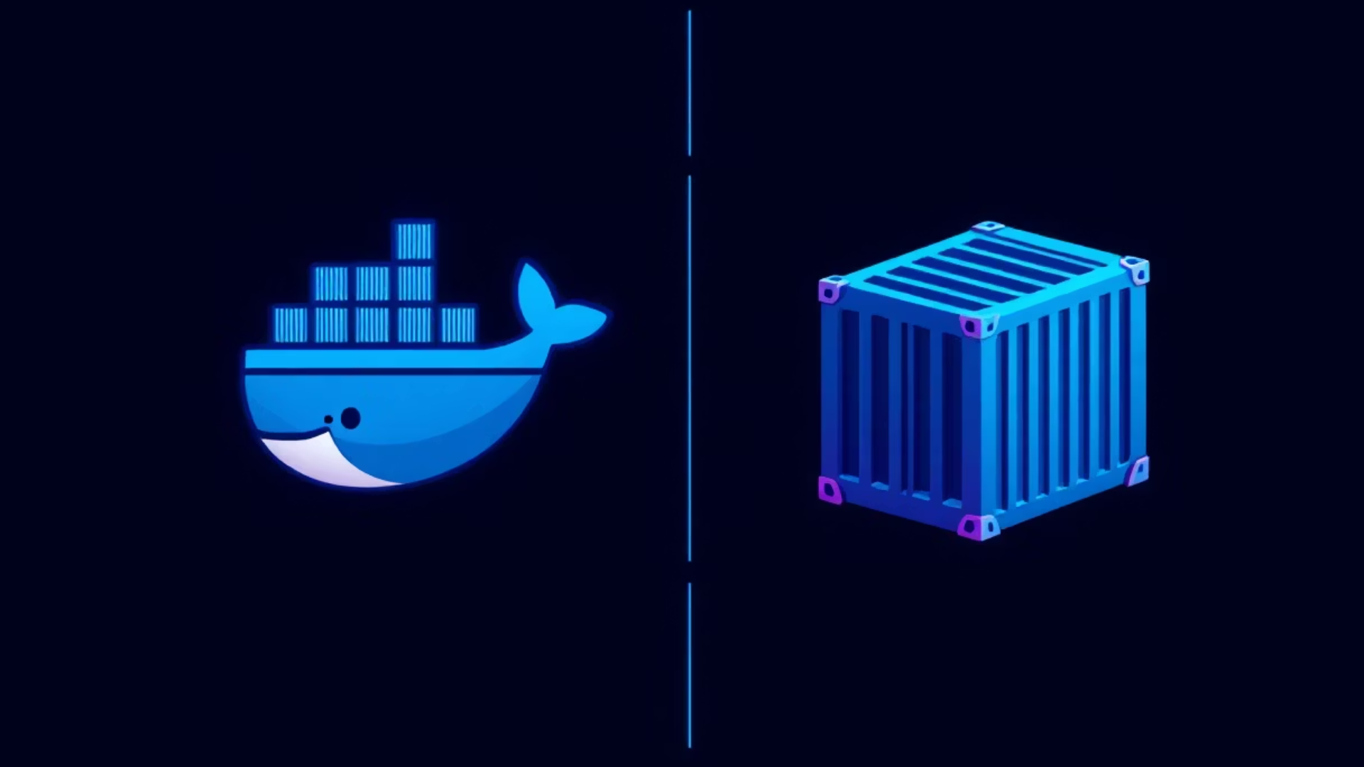
Images vs. Containers
Docker Images
Docker Containers
Read-only templates.
Runnable instances of
images.
Used to create containers.
Isolated environments.

Slide 14
CONCLUSION
Docker empowers DevOps by delivering speed, consistency, and scalability. It's the backbone of modern cloud-native development.
Docker isn't just a tool, it's a transformation — changing how software is built, shipped, and run in a DevOps-driven world.

Slide 15
THANK YOU

